Slide 1




Chapter 12:
Filecoin Retrieval Market
Beginners Guide to Filecoin
Content created by Brown Zhang
Researcher @ KEN Labs

Slide 2
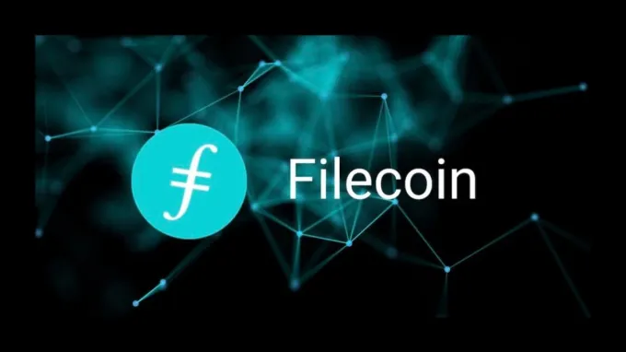
Background
First, a brief background on the Internet and the digital data explosion explains that as data volumes grow, so does the need for reliable and efficient data retrieval solutions.

Slide 3
Review Filecoin Storage Market
Data on Filecoin
The Storage Deal Flow
The Storage Mining subsystem
Storage miner and client considerations
Proof-of-Spacetime
Winning Proof-of-Spacetime
Window Proof-of-Spacetime
Faults

Slide 4
Filecoin Retrieval Market
At scale, caching data at the edge via an open market can solve for the speed of light problem and result in performant delivery at lower costs than traditional infrastructure.
The magic of content addressing (using fingerprints of content as the canonical reference) means data is verifiable.
This maps neatly to building a permissionless CDN — meaning anyone can supply infrastructure and serve content — as end users can always verify that the content they receive back is the content they requested (even from an untrusted computer).
If anyone can supply infrastructure into this permissionless network, a CDN can be created from a market of edge-caching nodes (rather than centrally planning where to put these nodes) and use incentive mechanisms to bootstrap hardware — leading to the optimal tradeoff on performance and cost.

Slide 5

The Role of Filecoin Retrieval Market
The retrieval market allows storage customers to request data retrieval from storage providers and pay tokens for fast and reliable data retrieval services.
Basic retrieval:
Lassie(Lassie is a simple retrieval client for IPFS and Filecoin.)
lassie fetch <CID>

Slide 6
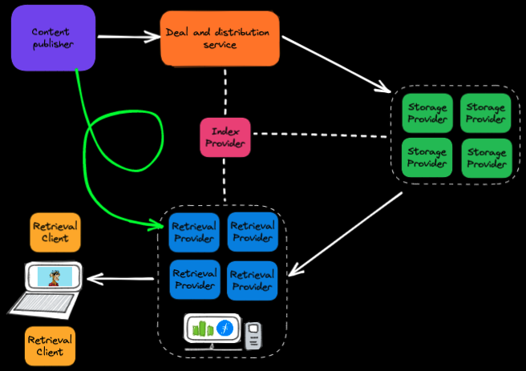
Retrieval Process
Discovery
Payment channel setup
Data transfer with payment

Slide 7
Data Security And Reliability
Data security, reliability and integrity are ensured through blockchain and smart contracts. The storage provider submits the storage certificate to verify the validity of its storage, so as to ensure that the storage customer obtains the correct data.

Slide 8
Filecoin Incentive
Filecoin incentive: Storage Provider Rewards, Retrieval Provider Rewards, Miner Competition and Ranking, Smart Contract Execution, Data Verification and Proofs, Punishment Mechanisms.
Retrieval Provider Rewards: Retrieval providers earn rewards by responding to retrieval requests and delivering data efficiently. Their rewards are determined by the quality of their retrieval services and response times. Successful and timely retrieval of requested data leads to token rewards for retrieval providers.

Slide 9
Conclusion
The Filecoin retrieval market is a crucial component of the network, facilitating efficient and reliable data access. Retrieval providers compete to fulfill user requests, offering fast and secure retrieval services. Through market-driven pricing and incentives, Filecoin ensures users can access their stored data quickly and seamlessly, leveraging its decentralized infrastructure and smart contracts for a robust and user-centric retrieval experience.

Slide 10


Feedback is welcomed.
https://github.com/kenlabs/Beginners-Guide-to-Filecoin

